Slide 1
Annotating accessibility during design. Include—Figma a11y plugin
Anna Zaremba | Megan Woodruff | Mark Lapole

Slide 2
Presenters
Anna
Megan
Mark

Slide 3
eBay context
A sports trading card is purchased every second (US)
A car part is purchased every second (UK)
A smartphone is purchased every 16 seconds (DE)
A watch is purchased every 95 seconds (AU)

Slide 4
Problem
About 40% of issues found in production are design-related

Slide 5
Goals
Deliver a more accessible, consistent & usable eBay experience

Slide 6
Who joined us today?

Slide 7
Remember a time when you felt overwhelmed...

Slide 8
What is your inclusive process?

Slide 9
As a designer, what if…
considering accessibility fitted seamlessly into your design process?

Slide 10
As an engineer, what if…
you had an efficient communication path and less guesswork?

Slide 11
As a project manager, what if…
you had clarity and confidence about what the team is building?

Slide 12
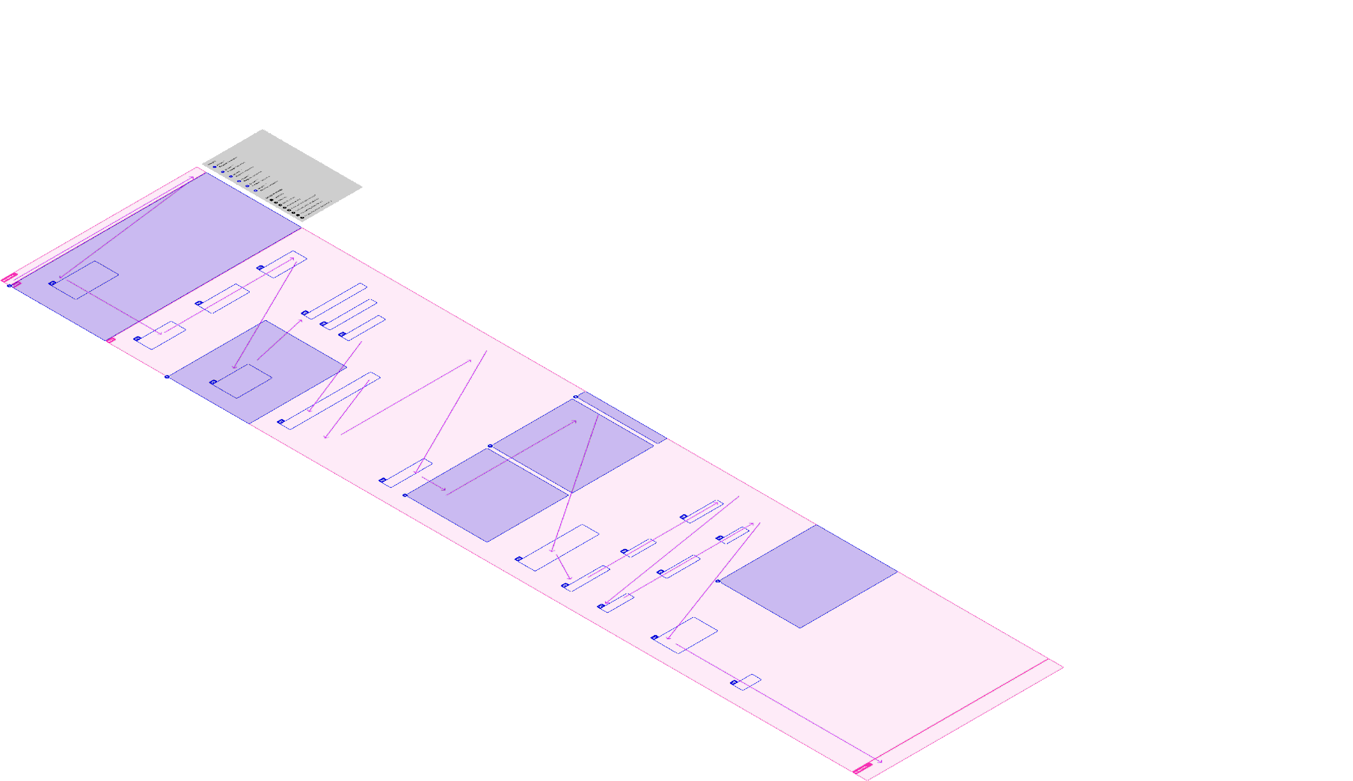
Introducing Figma accessibility plugin
design

Slide 13
Introducing Figma accessibility plugin
communicate

Slide 14
Introducing Figma accessibility plugin 3
build

Slide 15
What does the plugin provide?

Slide 16
Benefits
Comprehensiveness
Efficiency
Communication

Slide 17
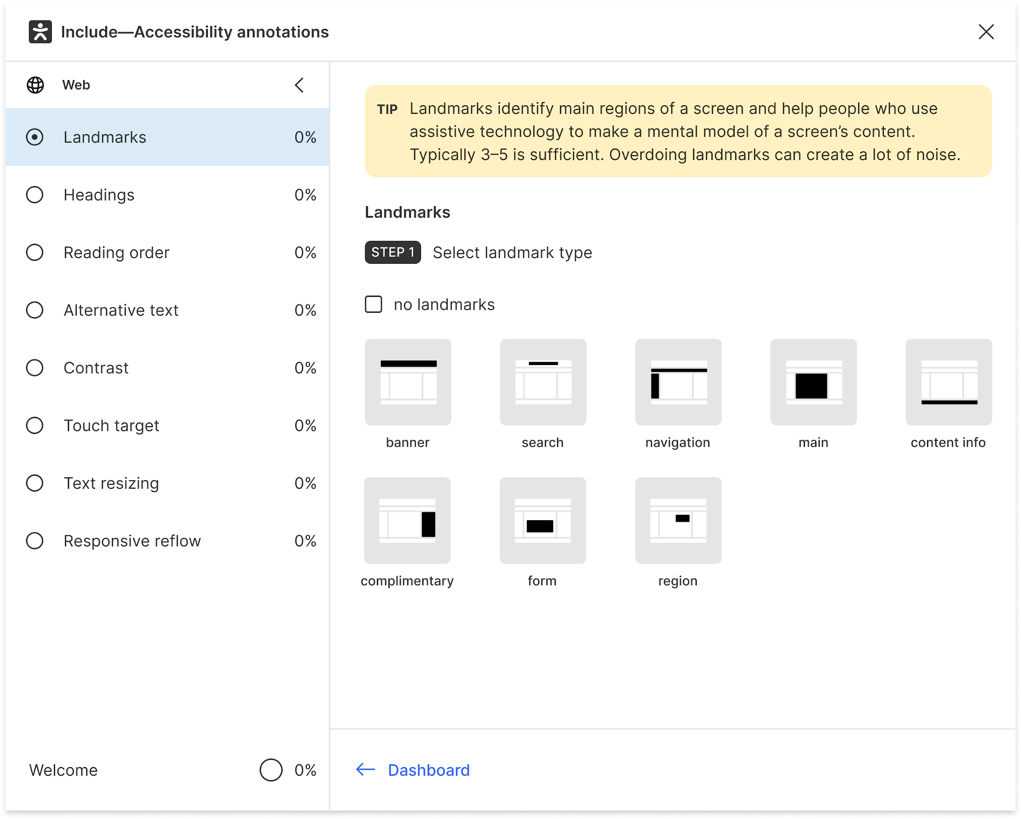
Comprehensiveness: multiple concepts

Slide 18
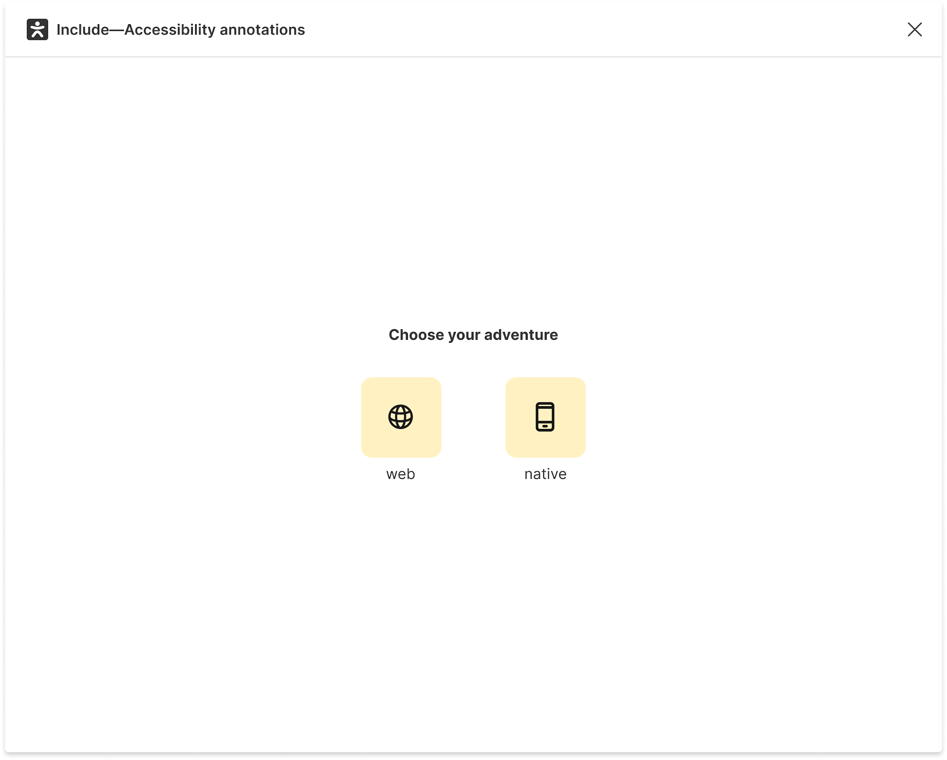
Comprehensiveness: multiple platforms

Slide 19
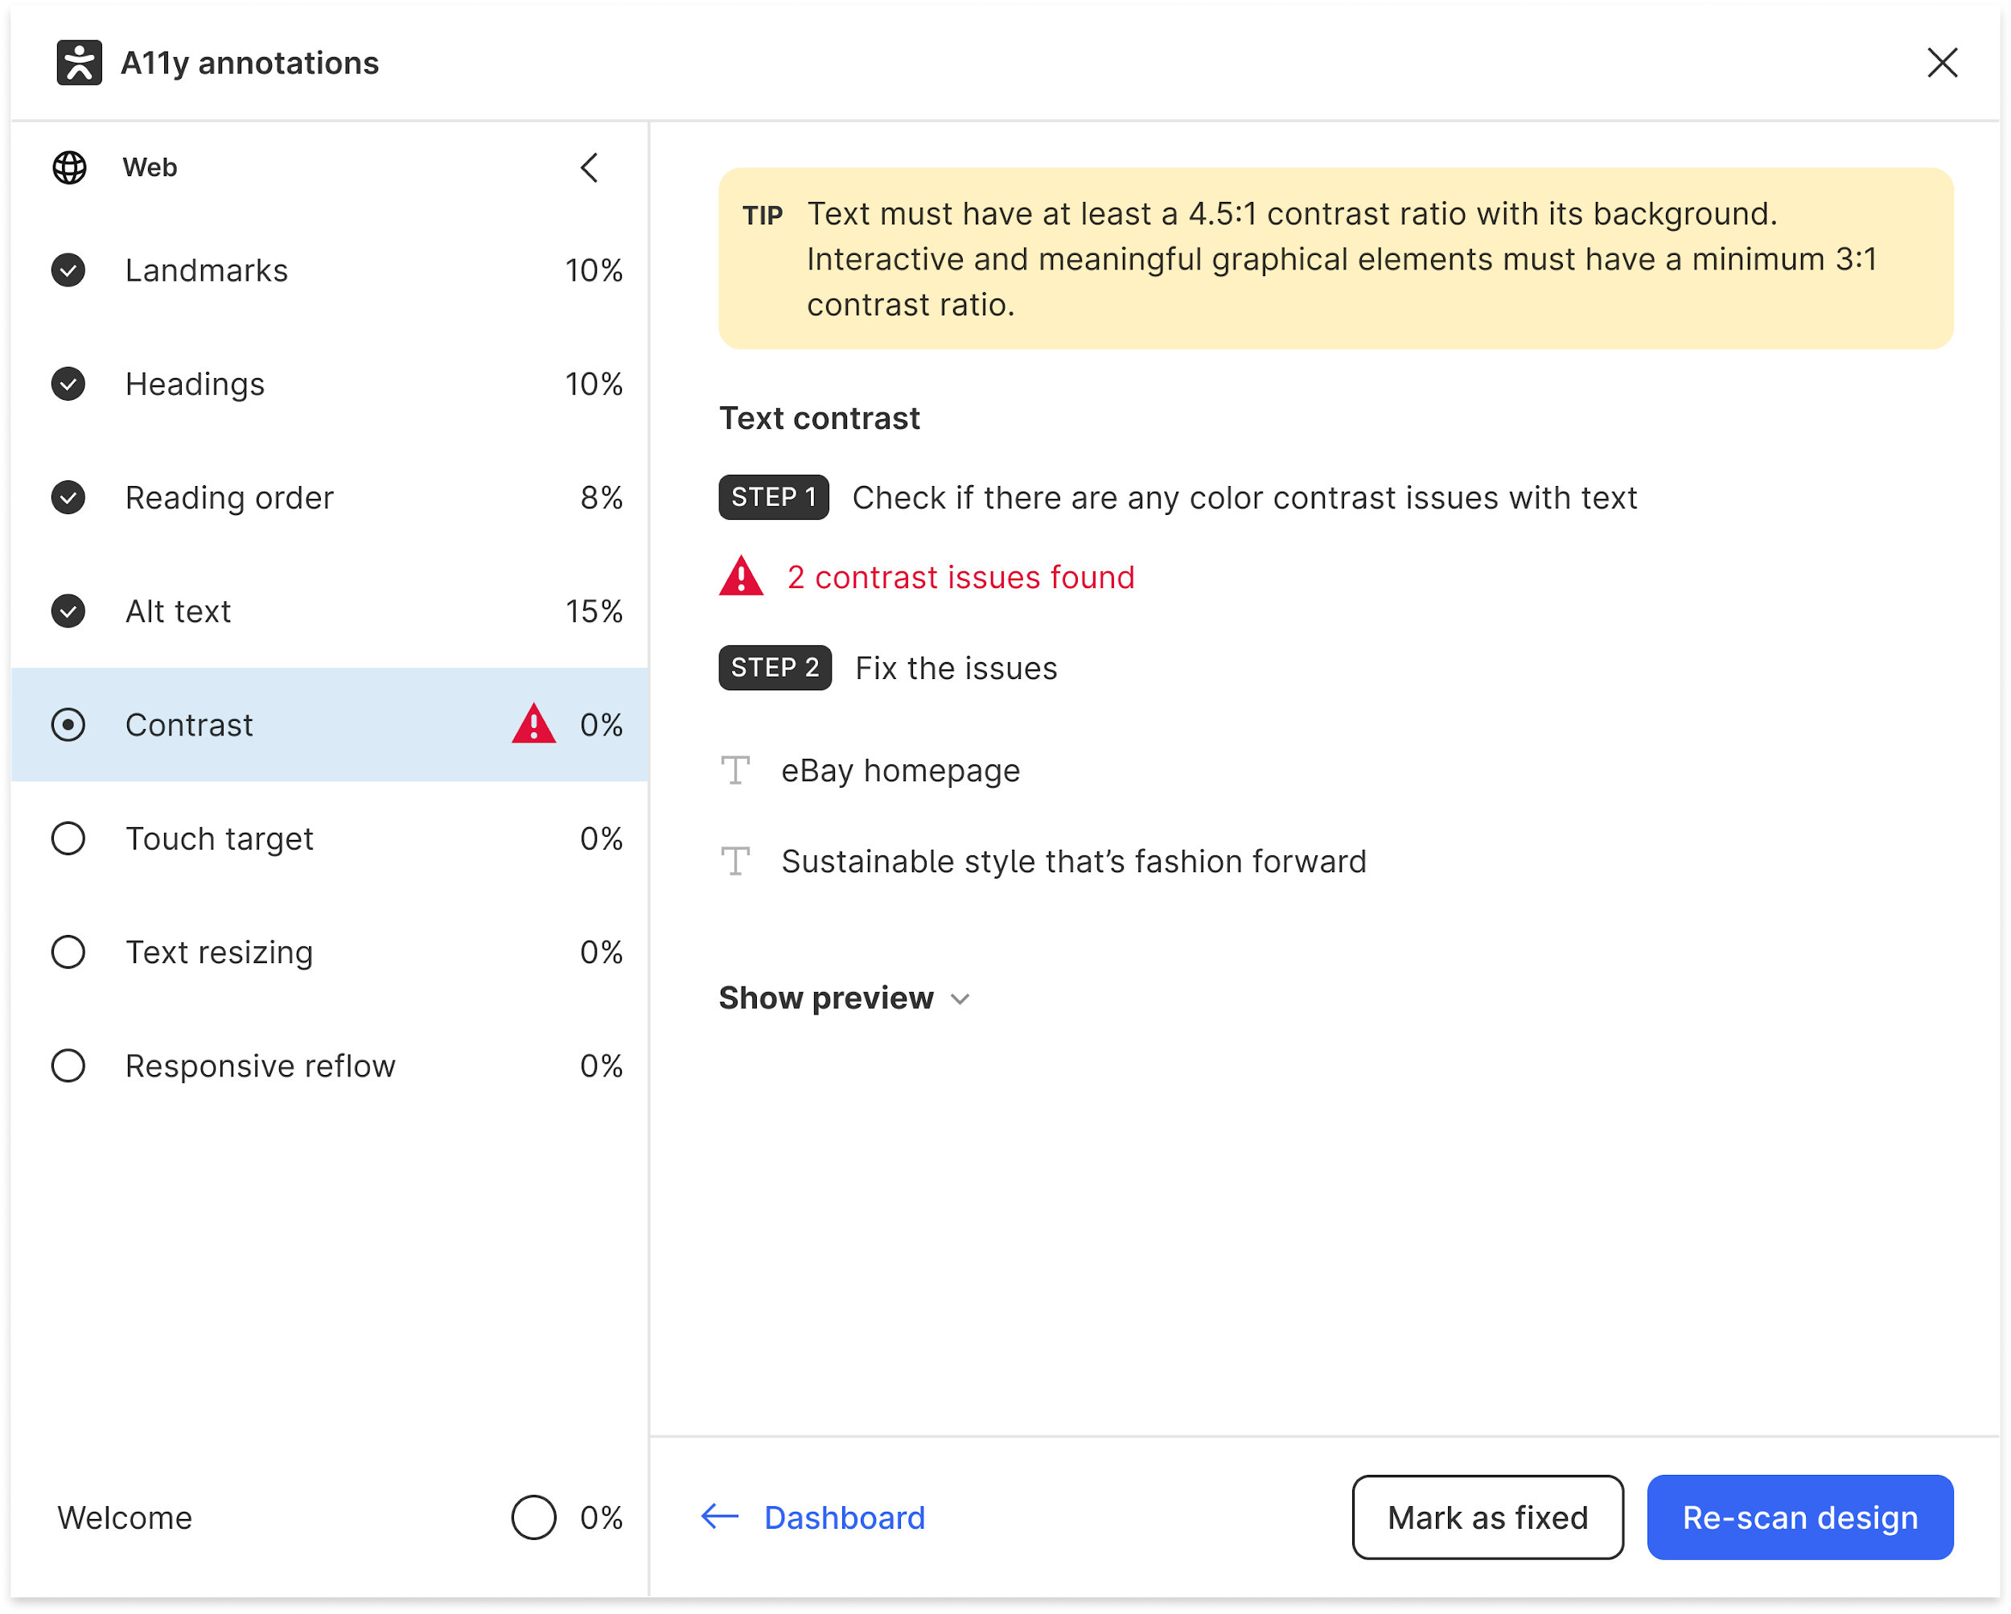
Efficiency: automated scans

Slide 20
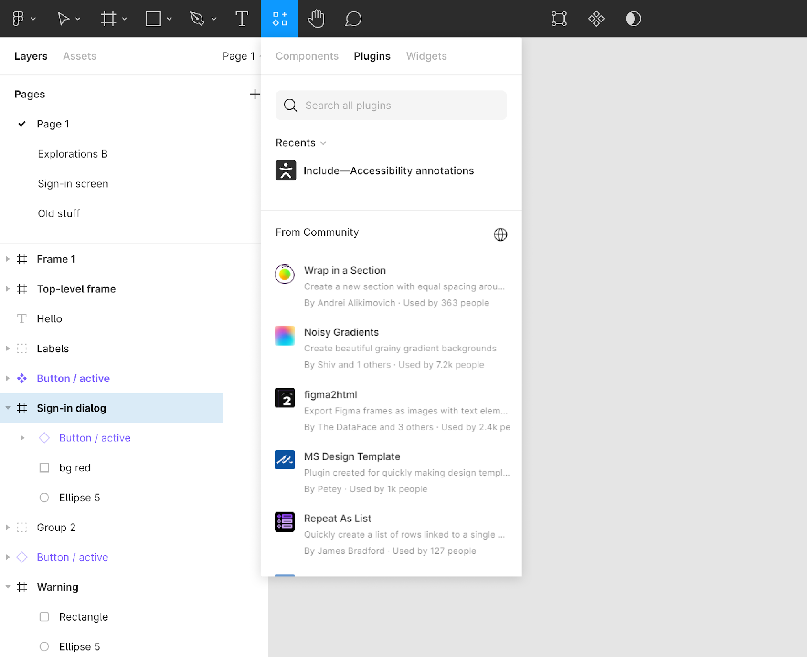
Efficiency: designer’s environment

Slide 21
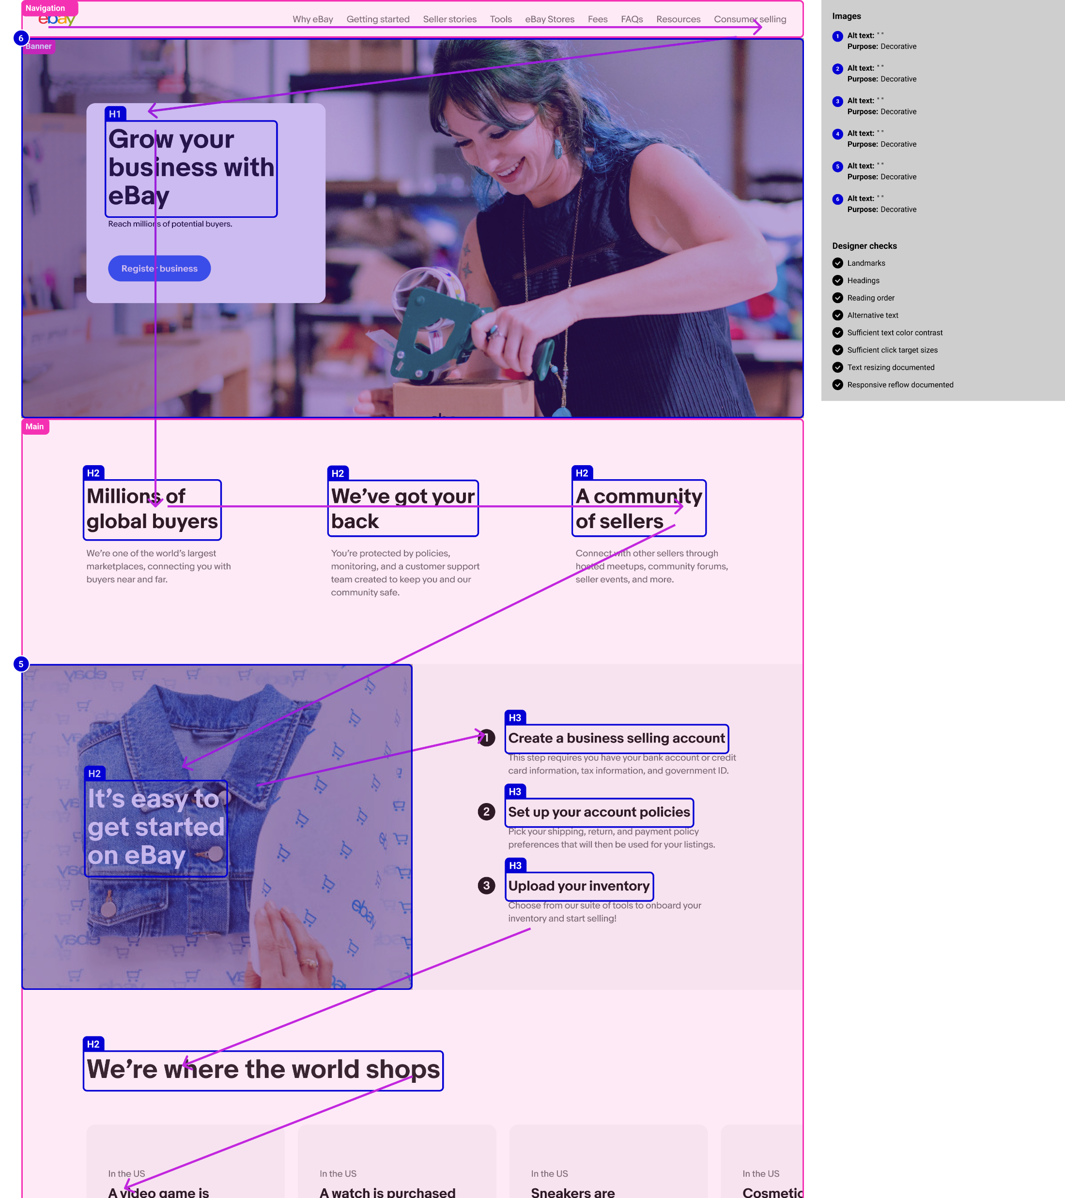
Communication developers’ view

Slide 22
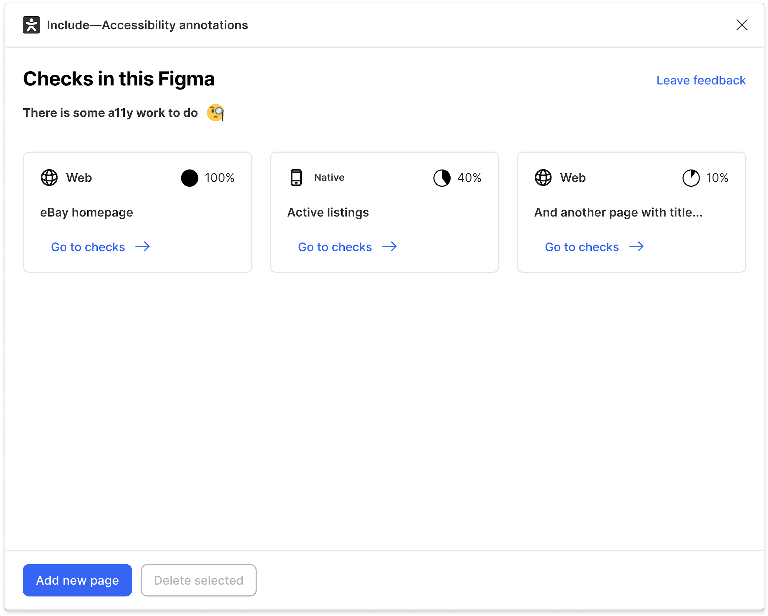
Demo

Slide 23
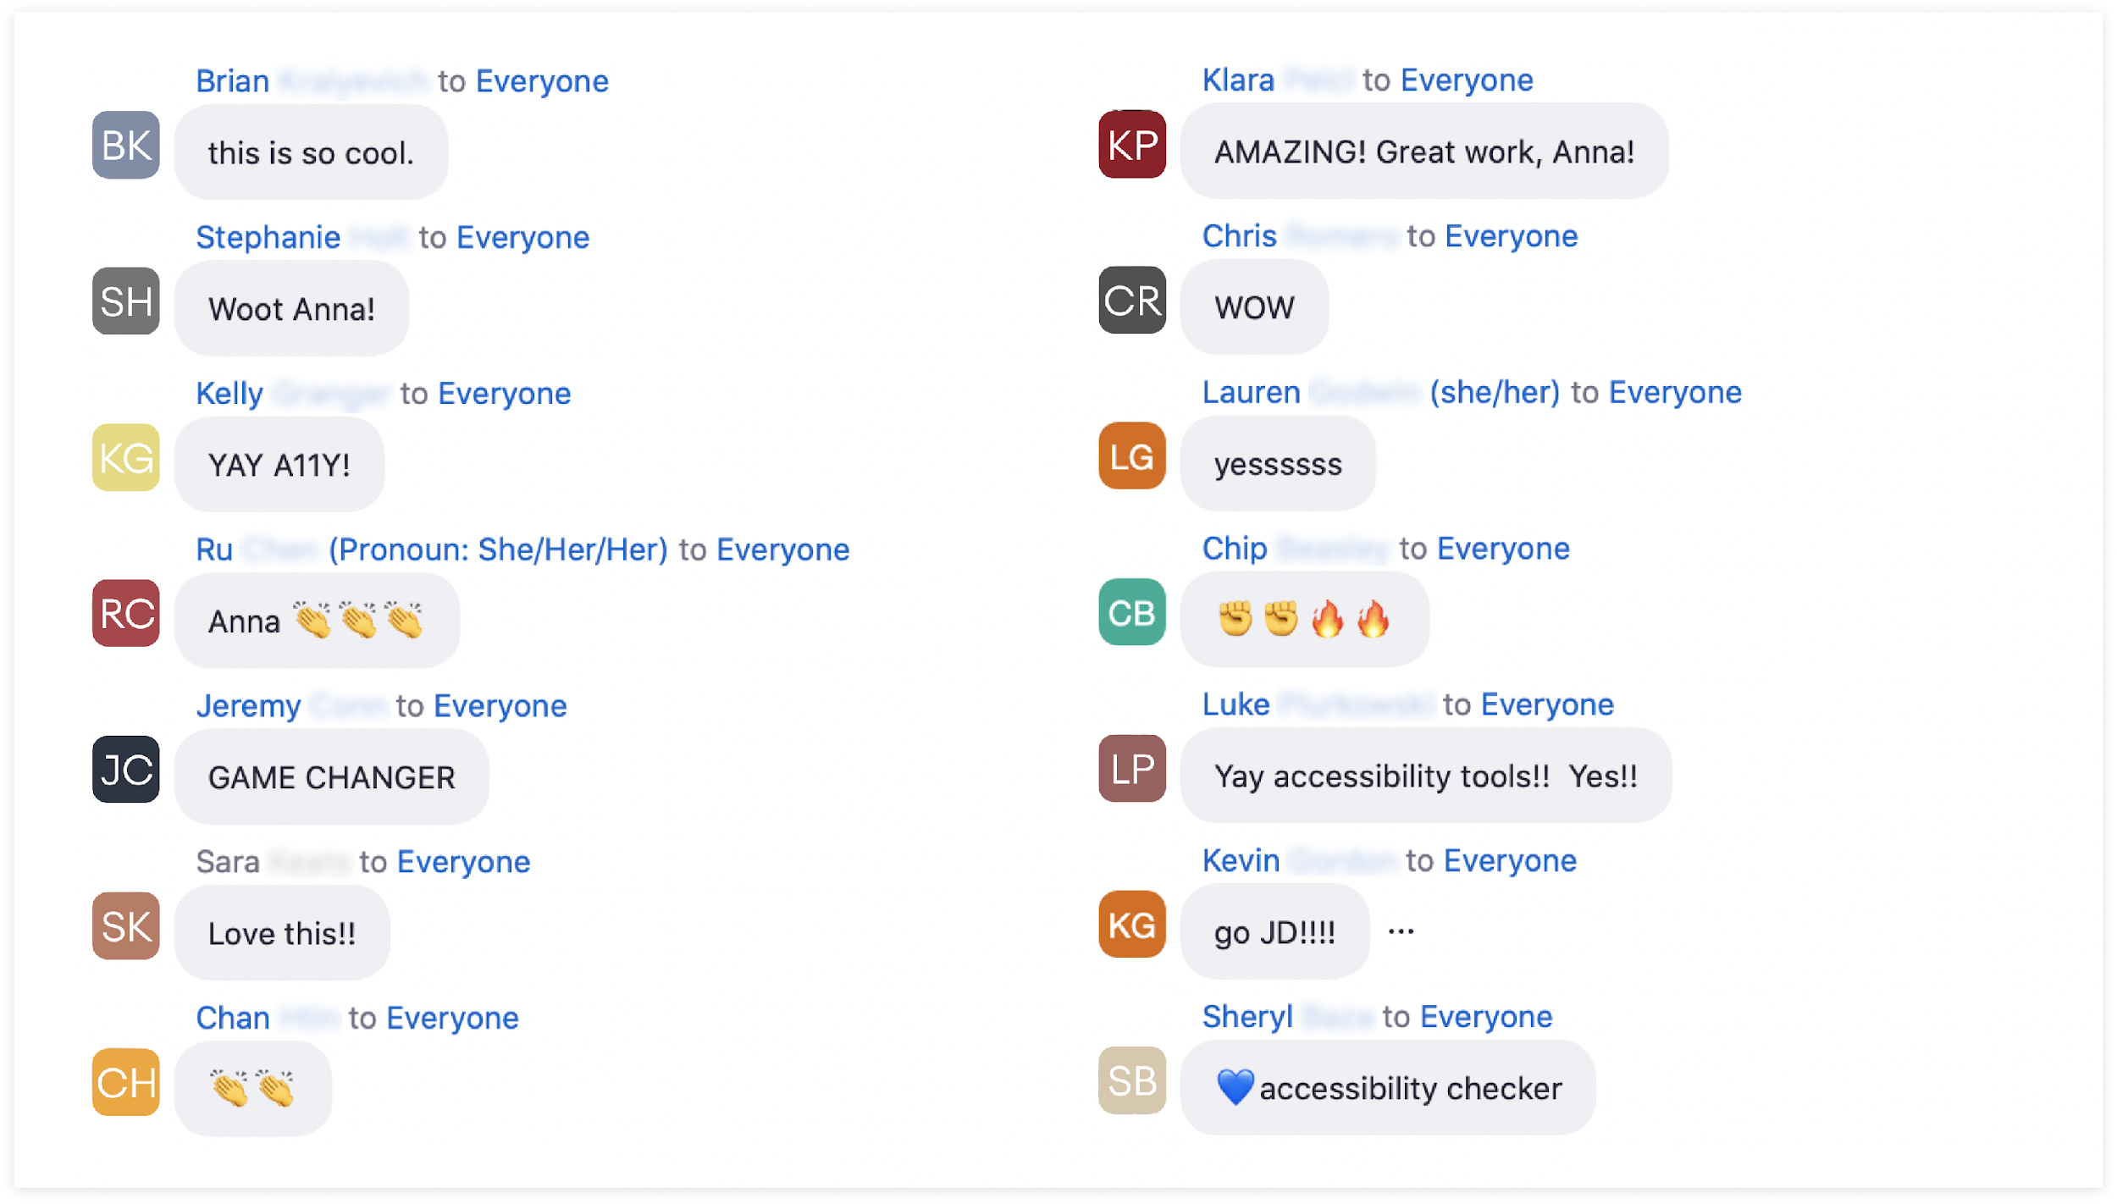
Early reactions

Slide 24
quote
This communication tool [...] is the customers’ lens of how we would want somebody to experience the design.”

Slide 25
Happy customer 3
Include— because well-crafted experiences consider accessibility from the start.

Slide 26
Thank you

Slide 27
Resources
Accessibility Plugin in Figma
Accessibility Plugin open source

